Slide 1


Counselling and Therapeutic Service
Children’s Guide
A Welcome and Introduction to Time to Listen for Children and Young People
Updated: July 2025

Slide 2

Time to Listen CIC
Hello 👋🏼
Welcome to Time to Listen!
I started working with Time to Listen’s kind and friendly therapists when I was 10 years old. I was very nervous at the start to accept their help. After a few sessions I began to put trust in my therapist. They were extremely patient with me and took things at my pace. I soon learnt that therapy isn’t frightening or weird. In fact, it’s the complete opposite! Therapy can help you work through trauma or tricky feelings giving you an opportunity to have an amazing future and life with your family.
Time to Listen have beautiful
therapy rooms that are cozy, safe and full of amazing resources.
There is an art room and a huge playroom along with a team of expert psychotherapists and counsellors who have been specifically chosen due to their qualifications and ability to work with children, young people and their families.
As you begin your support within Time to Listen my words of encouragement to you are: -
“Remember that there is always light at the end of the tunnel; trust in the process; and make the most of your therapy!”
Ruby x

Slide 3

What is Counselling?
What is counselling?
It is a safe space where you can talk about your feelings and thoughts
Why do people/young people go to counselling?
When they feel sad, worried, angry, confused or have specific problems, for example with school, friendships or family.
What does a counsellor do?
They will listen, help you to understand your feelings and support you in finding ways to feel better. They are not there to punish you or to judge you. They will provide a kind and caring relationship that is understanding and accepting.
Will the counsellor share our discussions with my parents/carers?
Our counselling service is confidential which means the things you say are private and will not be shared with your parents/carers or other people unless they feel you or someone else has or will come to some harm; then they will discuss with you who they need to share information with to keep you safe.
How long do the sessions last and how often will I need to attend?
Sessions are usually 50 minutes long and take place once a week.
I feel nervous about going to therapy. How will you help me to feel ok?
Your counsellor can show you around our building before you start your sessions so that you know where you will be coming to. Your counsellor will always offer you a drink and biscuit when you meet with them.
Your counsellor is used to helping children and young people with big emotions. If you find it hard to talk about your feelings, they will find creative ways to help you such as using music, mood cards, books, games and a range of toys and other items.
They will follow your lead and let you choose where to sit and how best to help you each week.
Your counsellor will be friendly, fun and kind.
What are my rights in counselling?
You can say how you feel.
You can ask questions.
You can stop if you feel uncomfortable.
You may spot “Poppy” at Time to Listen – one of our young trainee therapy dogs

Slide 4

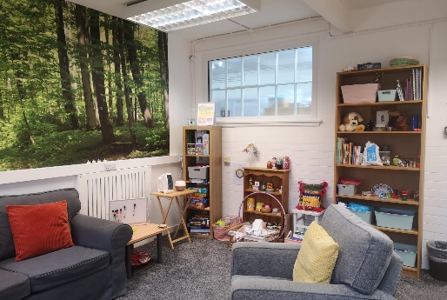

About Time to Listen CIC
Time to Listen was set up in July 2013 to help and support children, young people, and families and to provide counselling for adults.
We are based in Marvell House Children’s Centre in Hull.
Marvell House Children’s Centre
Time to Listen CIC was registered with Ofsted as an adoption support agency in January 2018. This means that Ofsted regularly checks that Time to Listen are doing things properly. They have visited us in February 2019 and in May 2023 and have written reports about their findings to tell people how we are doing.
After hearing what people had to say during these two visits, the Ofsted Inspectors said that Time to Listen is a good agency.
What is the Main Purpose of Time to Listen?
At Time to Listen we aim to be one of the best therapy and counselling services there is, with an experienced, understanding, dedicated and caring team who always strive to do their best to help children, young people and their families to do well and move forwards to a bright future.

Slide 5

Our Promise
At time to Listen we promise to CARE by being:
Confidential – we will keep your information private and won’t tell anyone what you’ve said unless we are concerned that you or someone else may come to some harm. We may also share information about you if you were unable to make the decision about sharing information yourself; or someone told us we had to share information by law, for example if the information was needed for a court case.
If your therapist does need to tell someone what you've told them, they should always try to tell you first.
Accepting – your therapist will respect your thoughts and feelings and the unique person that you are.
Respectful – your therapist will not judge or criticise you and will aways be kind and polite towards you and your family.
Empathic – your therapist will aim to understand how you are feeling even though they are not in the same, exact situation as yourself.
Helping and Supporting You
A therapy plan will be arranged for you to ensure that you and, if necessary, your family get the help and support that you need.

Slide 6


Therapies Provided
Our team offer a wider range of support that will enable you to explore and work through your thoughts and feelings.
Yourself and your counsellor will work out what type of therapy works best for you. Some children and young people prefer talking therapies whilst others can find it difficult to put things into words easily. Therefore, some children and young people like to get creative and make art whilst others use play to understand and express their thoughts and feelings.
We often work with parents and carers, too. We may therefore invite your parent(s) or carer(s) to attend appointments together with you and/or separately from you. This is important to ensure everyone in your family is considered and well supported whenever possible.
Tell Us What You Think
It’s always great to receive feedback so we know how we are doing, and we can understand how well we are supporting you and your family.
Your counsellor will ask you to fill in feedback forms at different stages of your therapy. However, you can always talk to your counsellor to give your feedback whenever you meet with them. You can also ask your parent(s) or carer(s) to send us an email or contact us via our website or by telephoning us to share your feedback.

Slide 7
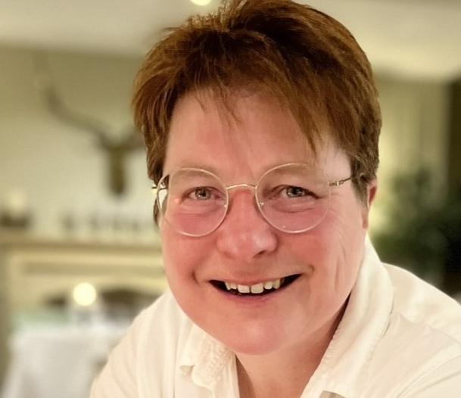




Complaints
If you and / or your family are not happy with Time to Listen, it is important that you let us know.
You or your parent(s) or carer(s) or another professional, such as a Social Worker can let us know. Firstly, you can make your counsellor aware. They will try very hard to resolve whatever it is about our service that you are not happy with.
The overall manager of Time to Listen is Janet. She is known as the Chief Executive of Time to Listen. If you think Janet needs to be made aware of your feedback either yourself, or your parent(s) or carer(s) or another professional, such as a Social Worker, please can get in touch with Janet.
If you do have a Social Worker involved in your care, we will let them know about your concerns regarding our service.
Contact Janet Woodhouse, Chief Executive (pictured above)
https://timetolisten.co.uk
07377 979950
janet.woodhouse@timetolisten.co.uk
Feedback and concerns can also be provided to Ofsted and to the organisations that our therapists are registered with.
Registered in England 08557572
Ofsted Registration No. 1250134
Time to Listen CIC
Marvell House Children’s Centre
Cranbourne Street
HULL
HU3 1PP
M: 07377 979950
E: info@timetolisten.co.uk

